Slide 1




Can We Obtain Fairness For Free?
Rashidul Islam, Shimei Pan, and James R. Foulds
Department of Information Systems
University of Maryland, Baltimore County
AIES-21 Conference, May 19-21, 2021
Work sponsored in part by NIST and NSF

Slide 2
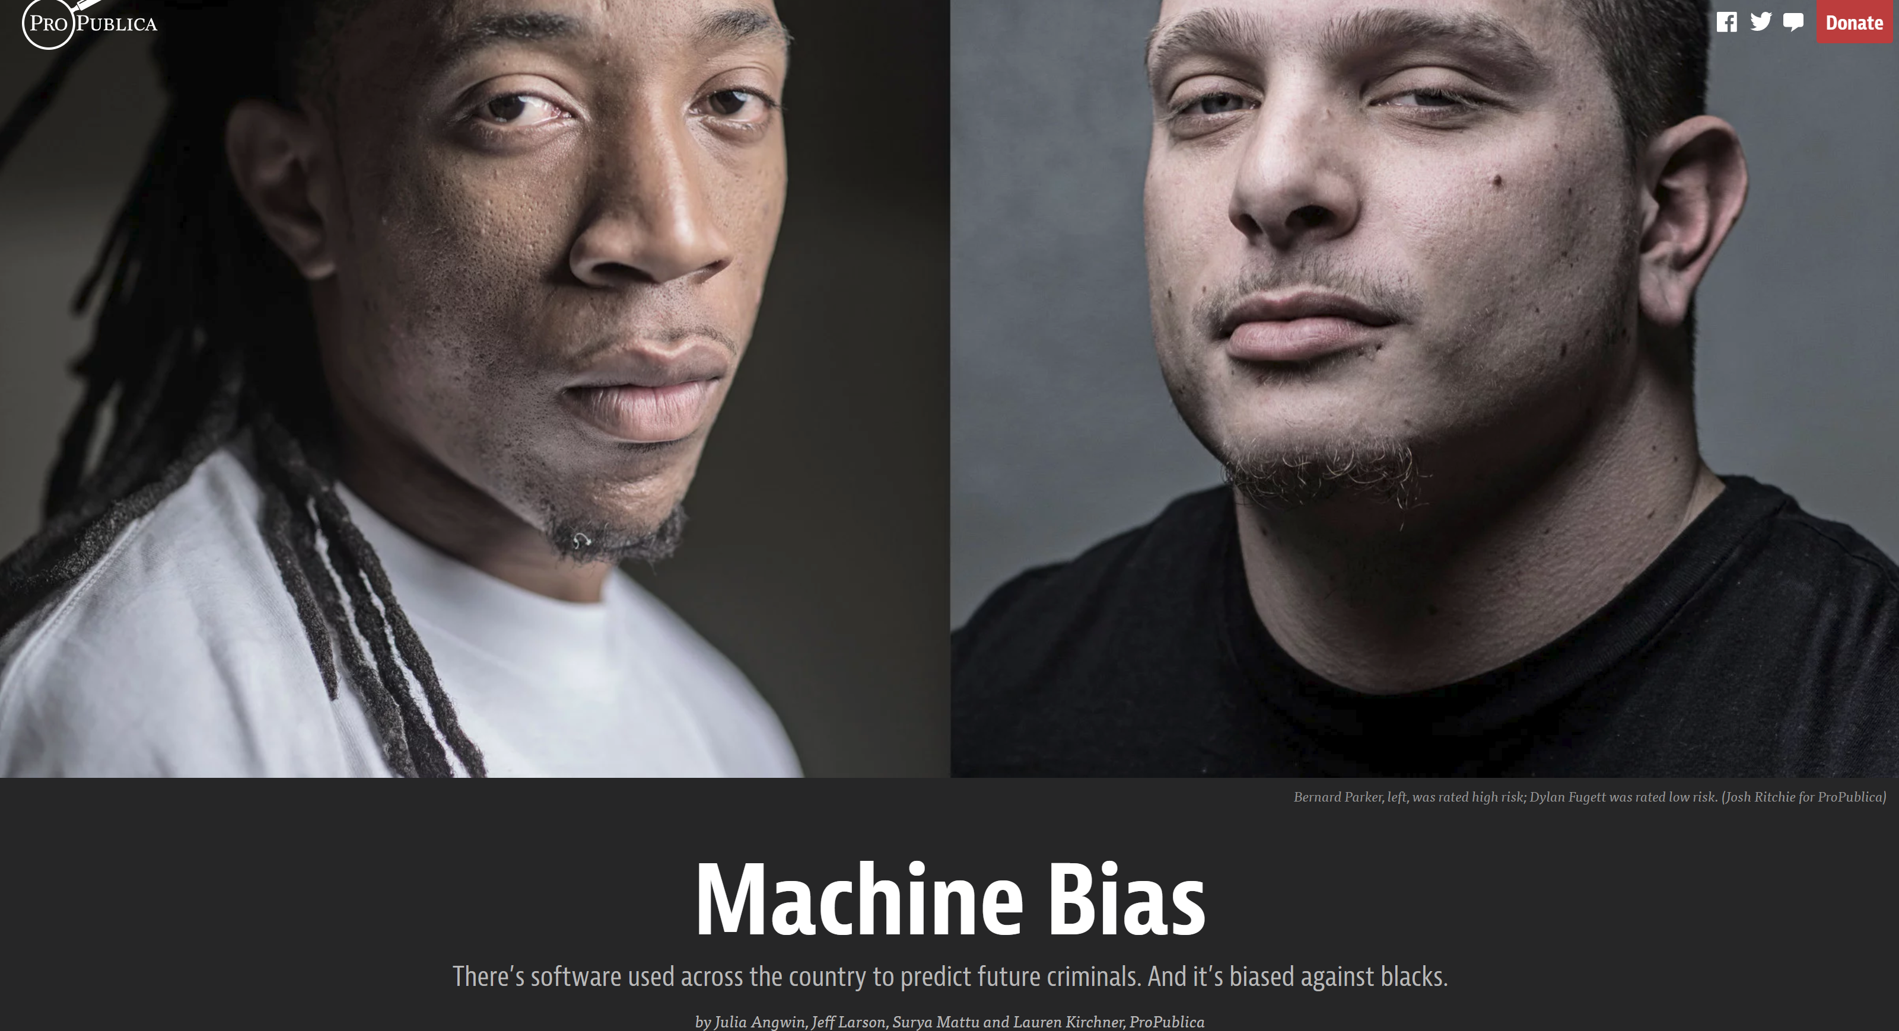
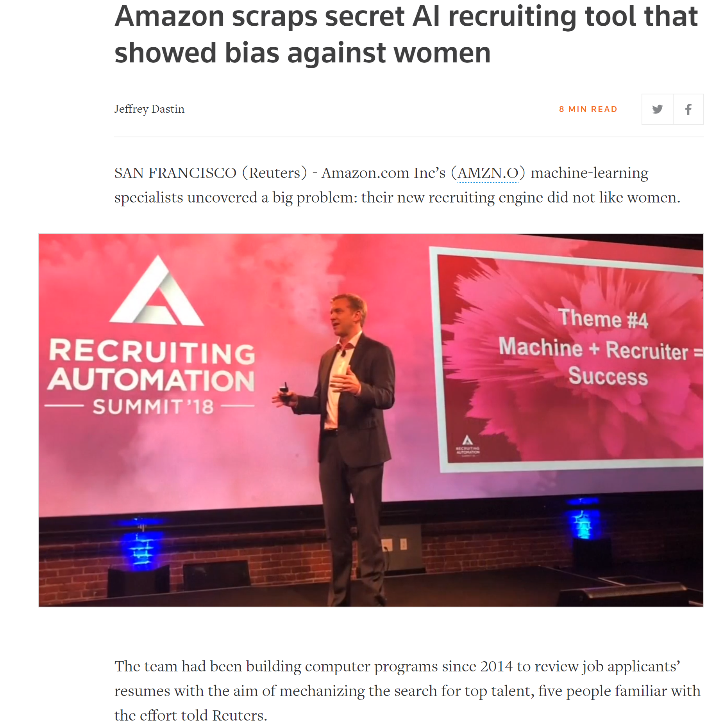
Motivation
There is growing awareness that AI and ML systems can in some cases learn to behave in unfair ways with harmful consequences.
J. Angwin, J. Larson, S. Mattu, and L. Kirchner, ProPublica, 2016

Slide 3
Motivation
AI community has invested a large amount of effort in this field
However, techniques for ensuring AI fairness have currently attained relatively little adoption in deployed AI systems
One of the main barriers: Fairness brings a cost in performance!
“Big Tech refuses to prioritize solving these issues over their bottom line.”
-- Kate Crawford. NYT, 2016

Slide 4
Our Research Questions?
Clearly fairness/performance trade-offs exist, but are they inevitable?
Is it possible to obtain some degree of improvement in fairness metrics for free, i.e., without sacrificing performance?
Notes:
relative to a typical ML model which does not aim to ensure fairness

Slide 5
Our Research Questions?
Clearly fairness/performance trade-offs exist, but are they inevitable?
Is it possible to obtain some degree of improvement in fairness metrics for free, i.e., without sacrificing performance?
Our study shows the answer is frequently yes!
We demonstrate cases where fair models can even improve accuracy

Slide 6
Fairness for Free
We identify two mechanisms that can potentially lead to fairness for free:
The regularization benefits of fairness penalties
It has potential to reduce overfitting, hence improving generalization performance on unseen data while reducing bias to some extent

Slide 7
Fairness for Free
We identify two mechanisms that can potentially lead to fairness for free:
“Gerrymandering” the errors
Multiple classifiers can potentially obtain same or similar number of errors
Some of those equally accurate classifiers may be more fair than others
Notes:
Secondly, it is also potentially possible to improve fairness without harming performance on the training data.
Multiple different classifiers can potentially obtain the same or a similar number of errors on the training set while making errors on different training instances, a phenomenon known as the Rashomon effect. Some of those equally accurate classifiers may be more fair than others under a desired fairness metric. We can improve fairness with no loss in performance by selecting the most fair classifier out of these equal-performing models.
“Gerrymandering” the errors between protected groups at a fixed training-set error rate to optimize fairness which will eventually improve fairness on the unseen data with no overall cost in performance
The solid-line classifier makes both errors on orange group instances, while the dashed-line classifier makes one error on an orange group instance and one error on a blue group instance.
While this example may seem contrived, practical experience with training deep neural networks, which generally converge to any number of local optima or saddle points of a highly non-convex objective function but obtain similar performance across runs, suggests that for these models there are many different solutions with similar predictive performance

Slide 8

Hyper-parameter Selection Strategy
Full Hyper-parameter Search (FHS) – our gold standard
Via grid search over all hyper-parameters, e.g., \# neurons/layer, activations etc. +
Select the model with the best (corresponding) fairness metric, such that accuracy is at least as good as for best typical model (TM)
Stage-wise Hyper-parameter Search (SHS) - faster alternative
Via grid search over only the fairness trade-off , holding the others fixed to TM
Like FHS, select best fair model
Notes:
Of these similar quality solutions for models, we can and should aim to pick the most fair option via sensible hyper-parameter selection strategies. We consider two strategies.
In both methods, , we first obtain the best TM based solely on accuracy measured on the development set model via a grid search over TM's hyper-parameters (e.g. \# neurons/layer, activation function, drop-out probability, etc.)
Our goal is to find a model which improves fairness over TM, while retaining or improving accuracy
In SHS, the fair model is assigned the same hyper-parameter values as the best TM.

Slide 9


Fair Learning Algorithms
Differential Fair Model (DFM)
Trade-off
parameter
Classifier’s
parameters
-DF measure
for classifier
J Foulds et al., ICDE, 2020
Notes:
In this study, we consider two standard fair ML methods, one of which encourages fairness using a penalty term, and the other approach learns fairness implicitly.

Slide 10

Fair Learning Algorithms
Adversarial Debiasing Model (ADM)
Trade-off
parameter
Classifier’s
parameters
Adversary’s parameters
Louppe et al., NeurIPS, 2017
Notes:
In this study, we consider two standard fair ML methods, one of which encourages fairness using a penalty term, and the other approach learns fairness implicitly.

Slide 11
Analysis on Grid Search
FHS on COMPAS
TM
DFM
ADM
Fairness for Free Region
A large number of fair models, both DFM and ADM, satisfied the criteria of ``fairness for free‘’ in terms of all the fairness metrics
Notes:
In our experiments, we used same DNN-based hyper-parameters to all models: typical or fair models. Similar set of \lambda values also used across fair models
We study several fairness metrics. We computed intersectional fairness metrics, e.g., \epsilon-DF and \gamma-SF with all protected attributes,
We also compute group fairness, e.g., \delta$-DP and p\%-Rule which were measured for each protected attribute such as gender, race} separately
Furthermore, we select the most marginalized subgroup (shown as mmsg) as the protected group e.g. black women}for COMPAS, in case of \delta-DP and p\%-Rule measurements, compared to its complement.
Orange region represents fairness for free area that has equal or higher accuracy and better corresponding fairness than the best TM.
Note that higher is better (orange area on right) for p% rule, while lower is better for other fairness metrics (orange area on left).
With the FHS approach, a large number of fair models, both DFM and ADM, satisfied the criteria of ``fairness for free‘’ in terms of all of the fairness metrics

Slide 12
Analysis on Grid Search
SHS on COMPAS
TM
DFM
ADM
Fairness for Free Region
Only a single ADM satisfied our criteria of ``fairness for free" for most of the fairness metrics
Notes:
The SHS approach did not perform as well in this experiment.

Slide 13
Analysis on Grid Search
We found similar results for FHS and SHS approach on other benchmark datasets:
Adult, Bank, and HHP data
Look through our paper for more experimental results!
Notes:
The SHS approach did not perform as well in this experiment.

Slide 14
Case Study on Overfitting
We compared the generalization of the TM with fair models on COMPAS
Accuracy of TM is higher on the train set
Fair models outperform TM on the test set
Overall conclusion: Fair models reduce overfitting which helps to improve both accuracy and fairness
Notes:
Compared to the other datasets in our experiments, we found that DNN-based models often exhibit more overfitting on COMPAS. This presents an opportunity for fair models to improve both accuracy and fairness using our approach.
In this experiment, we varied the number of hidden layers of all models. At every configuration of hidden layers, the best options for the models were selected using our FHS approach
Figure shows that the accuracy of TM is higher on the train set comparing to fair models when network size increases, while both fair models outperform TM on the test set with any network size. Furthermore, DFM and ADM decrease the corresponding gap between accuracy on train and test sets due to the regularization behavior of the fairness interventions

Slide 15
Conclusion
We investigated one of the major practical barriers
Cost in predictive performance when ensuring fairness
We showed experimentally that it is frequently possible to improve fairness to some degree while avoiding cost of predictive performance
In future, we aim to develop a learning algorithm that directly solves constrained optimization problem for ``fairness for free" methods
We hope that our results will encourage further research in addressing the human-facing barriers to increase deployment of fair AI methods
Notes:
to the wide deployment of fair AI/ML systems across industry, government, and the public sector
We hope that our results will encourage further research in addressing the human-facing barriers to deployment of fair AI methods, leading to increased real-world societal benefit from these technologies

Slide 16
Thank You!
Contact:
Rashidul Islam
Graduate Research Assistant,
Foulds Research Group
Ph.D. Student, Dept. of Information Systems
University of Maryland, Baltimore County
Email: islam.rashidul@umbc.edu
web: https://rashid-islam.github.io/homepage//

